Slide 1
Network Security –Attacks and Measurements
Liu Cui

Slide 2
Road Map
Denial-of-Service Attacks
Firewalls
Tunneling
Intrusion Detection System (IDS)
Intrusion Prevention System (IPS)

Slide 3

Denial-of-Service Attacks
Because bandwidth in a network is finite, the number of connections a web server can maintain to clients is limited.
Each connection to a server needs a minimum amount of network capacity to function.
When a server has used up its bandwidth or the ability of its processors to respond to requests, then additional attempted connections are dropped and some potential clients will be unable to access the resources provided by the server.
Any attack that is designed to cause a machine or piece of software to be unavailable and unable to perform its basic functionality is known as a Denial-of-Service (DoS) attack.

Slide 4
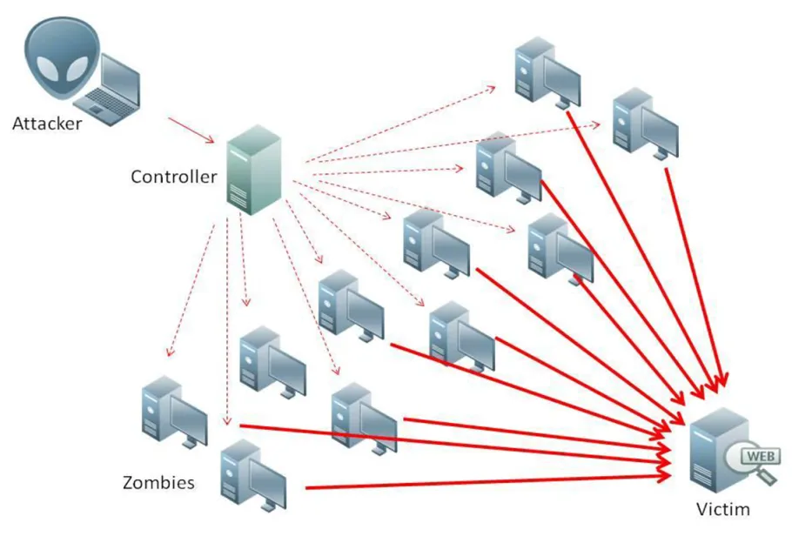
Denial-of-Service Attacks
Spoofing the source IP address is commonly used to obscure the identity of the attacker as well as make mitigation of the attack more difficult.
Because some servers may stop DOS attacks by dropping all packets from certain blacklisted IP addresses, attackers can generate a unique source IP address for every packet sent, preventing the target from successfully identifying and blocking the attacker.

Slide 5
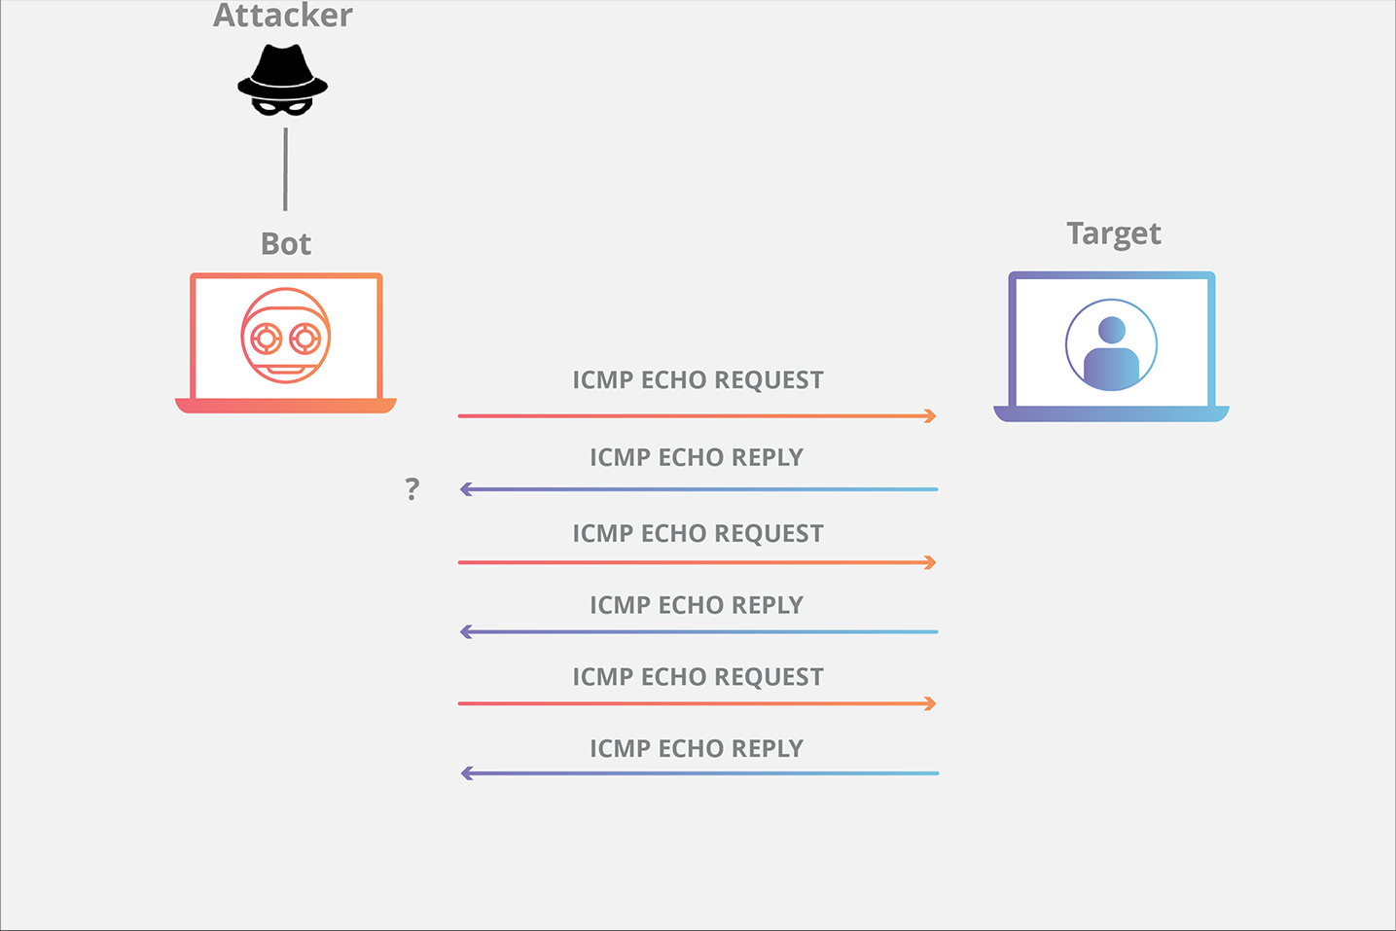
DOS – the Ping Flood Attack
A powerful machine sends a massive amounts of echo requests to a single victim server.
If the attacker can create many more ping requests than the victim can process, and the victim has enough network bandwidth to receive all these requests, then the victim server will be overwhelmed with the traffic and start to drop legitimate connections

Slide 6
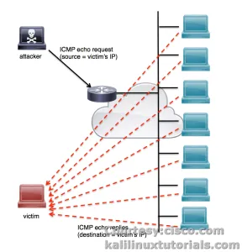
DOS – the Smurf Attack
Many networks features a broadcast address by which a user can send a packet that is received by every IP address on the network.
Smurf attacks exploit this property by sending ICMP packets with a source address set to the target and with a destination address set to the broadcast address of a network
Once sent, each packet is received by every machine on the network, at which point every machine sends a reply ICMP packet to the indicated source address of the target.
This results in an amplification effect that multiplies the number of packets sent by the number of machines on the network.

Slide 7
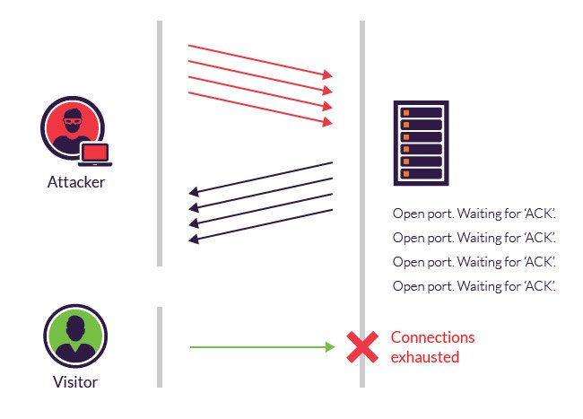
DOS – the SYN Flood Attack
An attacker sends a large number of SYN packets to the server, ignores the SYN/ACK replies, and never sends the expected ACK packets back.
The server’s memory will fill up with sequence numbers that it is remembering in order to match up TCP sessions with expected ACK packets
These ACK packets will never arrive, so this wasted memory ultimately blocks out other, legitimate TCP session requests.

Slide 8
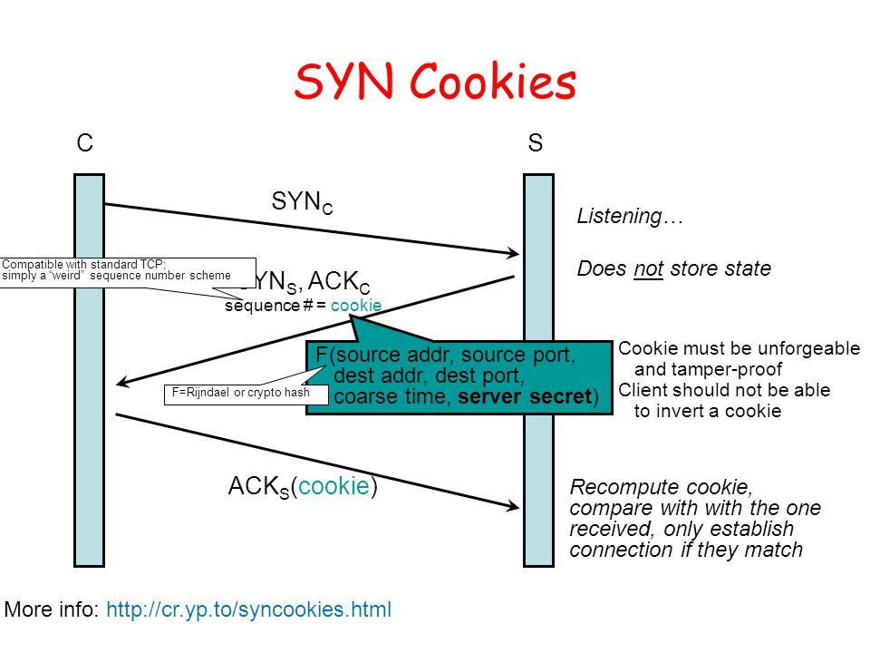
DOS – Defenses Against SYN Flood Attack
Notes:
When SYN cookies are implemented, rather than dropping connections because its memory is filled, the server sends a specially crafted SYN/ACK packet without creating a corresponding memory entry. In this response packet, the server encodes information in the TCP sequence number as follows:
The first 5 bits are timestamp realized as a counter incremented every minute modulos 32.
The next 3 bits are an encoded value representing the maximum segment size of transmission
The final 24 bits are a MAC of the server and client IP addresses, the server and client port numbers, and the previously used timestamp, computed using a secret key.
According to the TCP specification, a legitimate client must reply with a sequence number equal to the previously sent sequence number plus 1. Therefore, when a client replies with an ACK packet, the server substracts 1 to obtain the previously sent sequence number. It then compares the first 5 bits with the current timestamp to check if the connection has expired. Next, the server recomputes the 24-bits MAC using known IP and port information and compares with the value encoded in the sequence number. Finally, the server decodes the middle 3 bits to finish reconstructing the SYN queue entry, at which point the TCP connection can continue. If everything checks out with this SYN cookie check, then the server initiates the TCP session.

Slide 9
DOS – Optimistic TCP ACK Attack
Congestion Control
The number of TCP packets allowed to be outstanding during a TCP communication session before requiring an ACK is known as a congestion window.
The window size grows when ACKs are received, and shrinks when segments arrive out of order or are not received at all, indicating missing data.
In so doing, TCP helps to keep network congestion down while also trying to push data through the Internet as quickly as possible without overloading the capacity of the routers along the path that the packets are traveling.

Slide 10
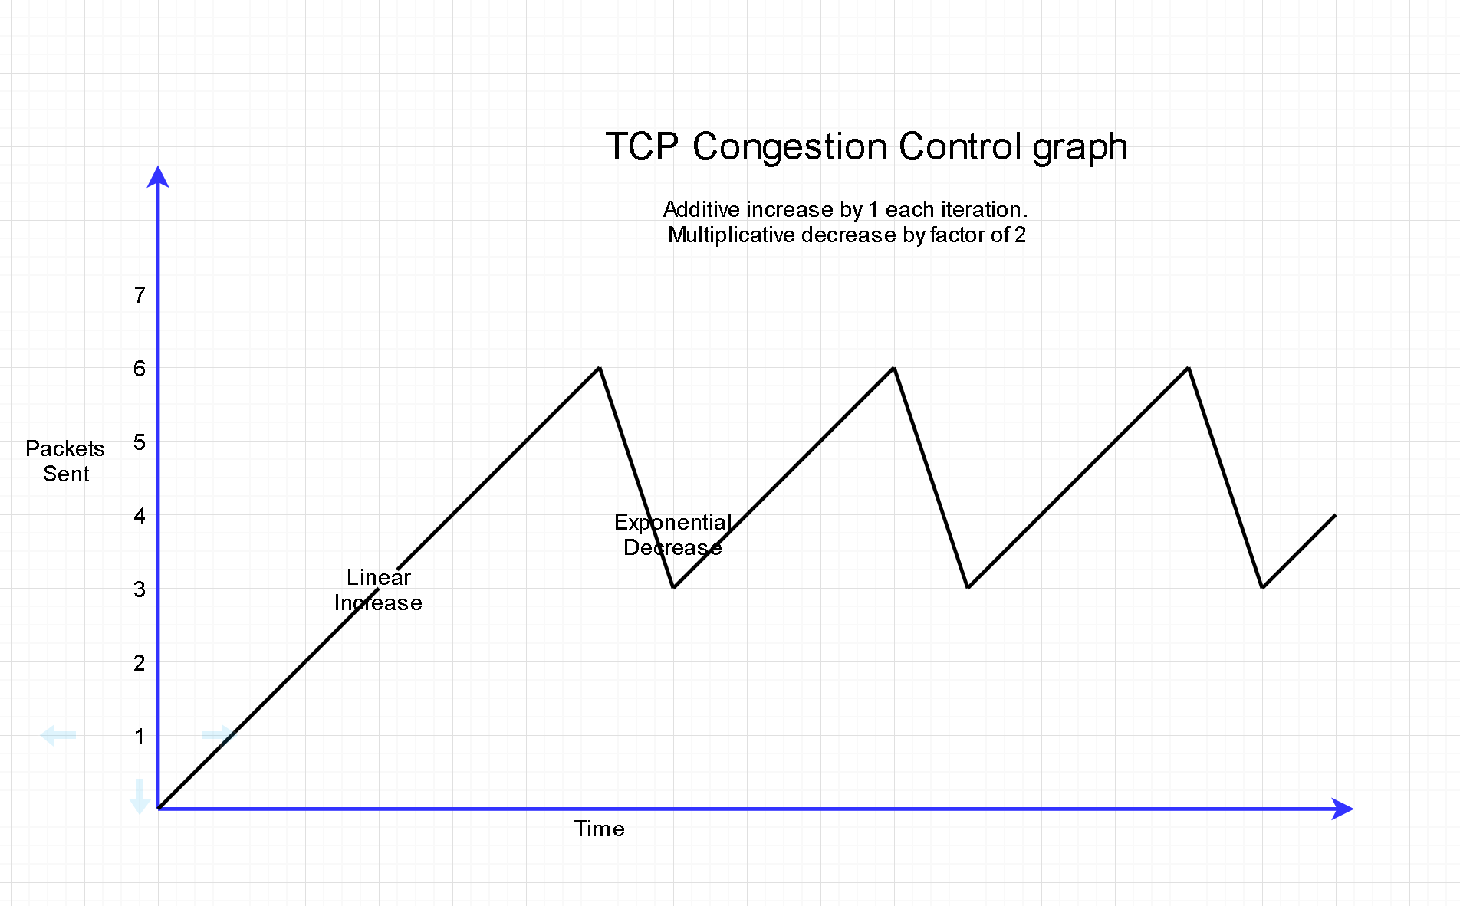
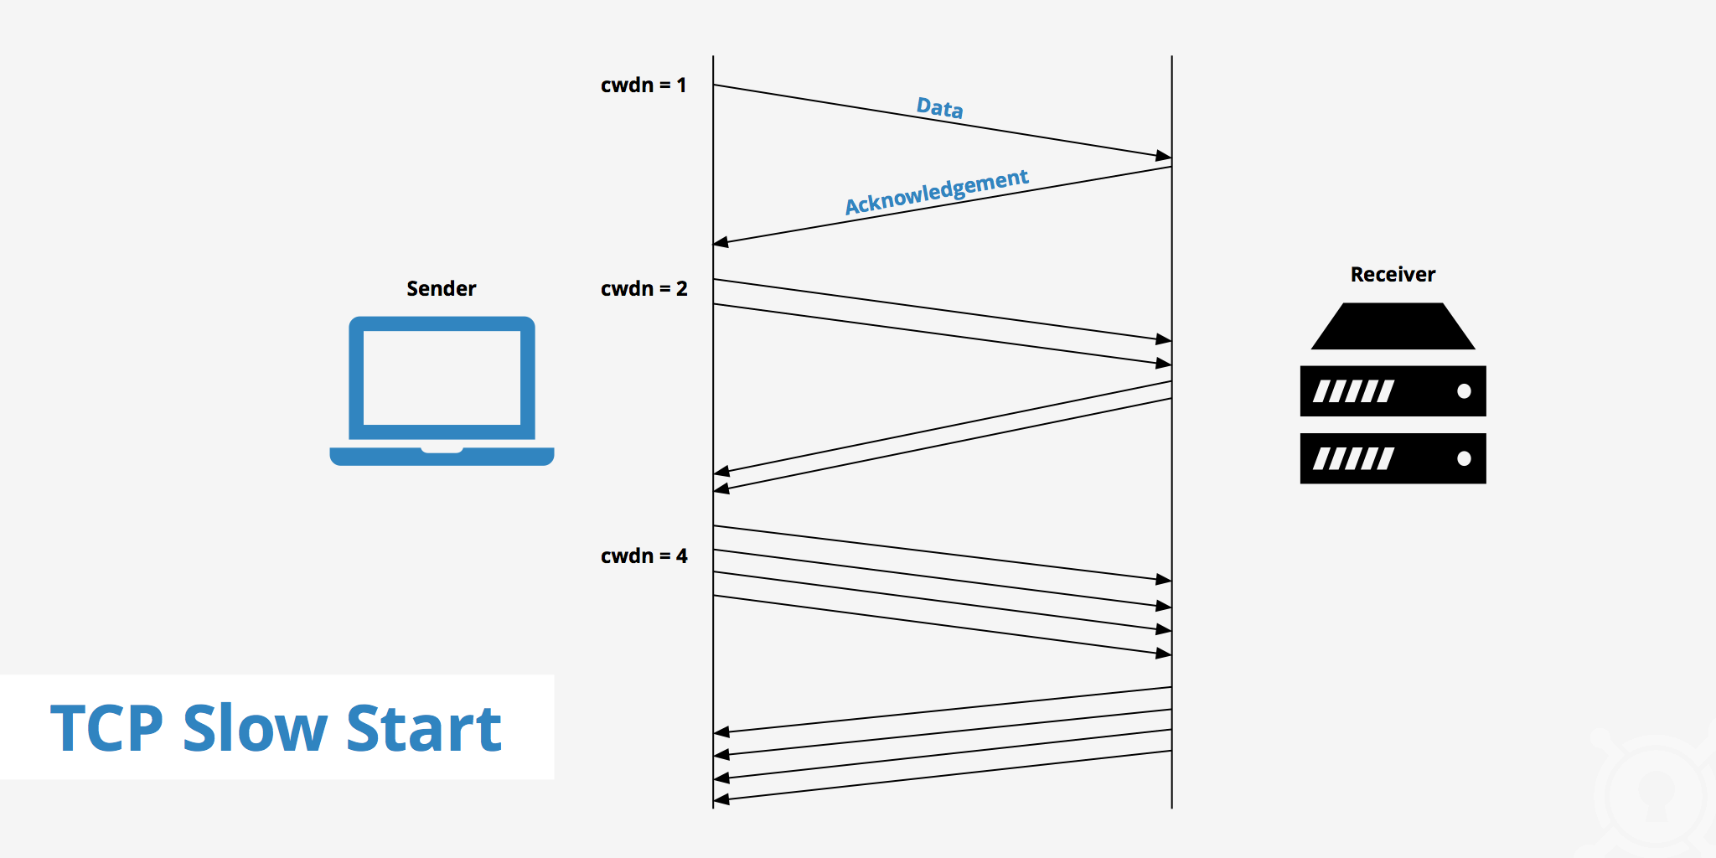
DOS – Optimistic TCP ACK Attack
Congestion Control

Slide 11
DOS – Optimistic TCP ACK Attack
A rogue client tried to make a server increase its sending rate until it runs out of bandwidth and cannot effectively serve anyone else.
If performed simultaneously against many servers, this attack can also create Internet-wide congestion.
The aim of the client is to acknowledge “in-flight” packets, which have been sent by the server but have not yet been received by the client.
Defense: set maximum traffic limits per client at the server level.

Slide 12
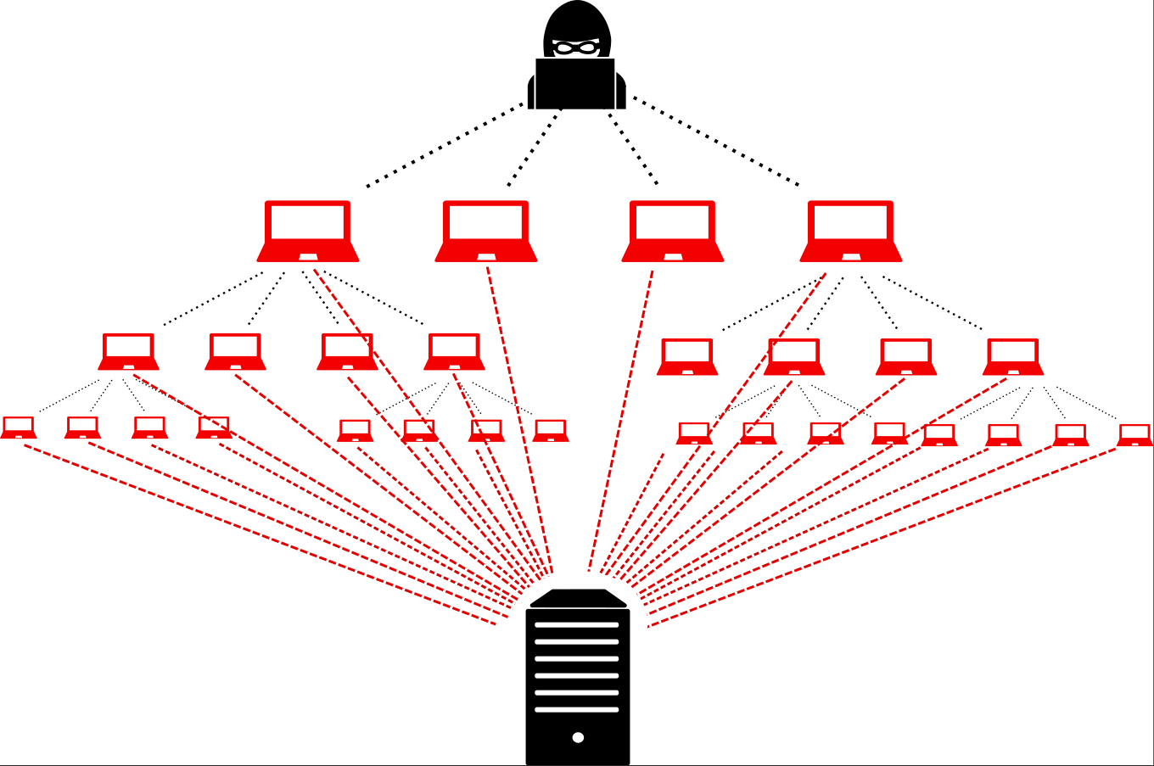
Distributed Denial-Of-Service
Malicious users leverage the power of many machines (sometimes hundreds or even thousands) to direct traffic against a single web site in an attempt to create denial-of-service conditions.
In theory, there is no way to completely eliminate the possibility of a DDOS attack, since the bandwidth a server is able to provide its users will always be limited.
Many servers incorporate DOS protection mechanisms that analyze incoming traffic and drop packets from sources that are consuming too much bandwidth.
Unfortunately, IP spoofing may make DDOS prevention more difficult

Slide 13
Firewalls
A firewall can be employed to filter incoming or outgoing traffic based on a predefined set of rules that are called firewall policies.
Firewalls may be used both as a protective measure, to shield internal network users from malicious attackers on the Internet, or a means of censorship.
Firewalls can be implemented in either hardware or software, and are typically deployed at the perimeter of an internal network, at the point where that network connects to the Internet.

Slide 14
Firewall Policies
Packets flowing through a firewall can have one of three outcomes:
Accepted: permitted through the firewall
Dropped: not allowed through with no indication of failure
Rejected: not allowed through, accompanied by an attempt to inform the source that the packet was rejected
Blacklists (default-allow ruleset): all packets are allowed through except those that fit the rules defined specifically in a blacklist.
Whitelists (default-deny policy): all packets are dropped or rejected unless they are specifically allowed by the firewall.

Slide 15
Stateless Firewalls
Stateless Firewalls: it treats each packet attempting to travel through it in isolation without considering packets that is has processed previously.
In particular, stateless firewalls don’t have any memory dedicated to determining if a given packet is part of an existing connection.
It simply inspect packets and apply rules based on the source and destination IP addresses and ports.
Notes:
While stateless firewalls provide a starting point for managing traffic flow between two untrusted zones and require little overhead, they lack flexibility and often require a choice between limited functionality and lax security. Consider the case of a user on the internal network wishing to connect via TCP to an external wev site. First, the user initiates the connection by sending a TCP packet marked with the SYN flag set. In order for this packet to be allowed, the firewall must permit outbound packets originating at the user’s IP from whichever port the user sends the request. Next, the web server responds with a packet that has the SYN and ACK flags set. For this packet to be allowed through, the firewall must allow inbound packets sent from the web server, presumably originating from the appropriate port for web traffic.
Note that if the above policy were in place, all traffic from a web server originating at the default port for web servers would be allowed through the firewall to the user’s machine, which may be undesirable. This policy can be tightened somewhat by observing that the firewall does not need to allow TCP packets marked with just the SYN flag to reach the user. While this restriction would prevent outside parties from initiating TCP connections to an internal machine, it would not prevent them from probing the network with other packets not marked with the SYN flag

Slide 16
Stateful Firewalls
Stateful firewalls can tell when packets are part of legitimate sessions originating within a trusted network.
Stateful firewalls maintain tables containing information on each active connection, including the IP addresses, ports, and sequence numbers of packets.

Slide 17
Tunneling
The contents of TCP packets are not normally encrypted, so if someone is eavesdropping on a TCP connection, he can often see the complete contents of the payloads in this session.
One way to prevent such eavesdropping without changing the software performing the communication is to use a tunneling protocol.
In such a protocol, the communication between a client and server is automatically encrypted, so that useful eavesdropping is infeasible.
To use such a protocol, the client and server have to have some way of establishing encryption and decryption keys, so using a tunneling protocol requires some setup.

Slide 18
Tunneling – Secure Shell (SSH)
Remote access: telnet, FTP, and rlogin no encryption
SSH uses symmetric and public-key cryptography to communicate across the Internet using an encrypted channel.
To establish an SSH connection, a client and server go through the following steps:
The client connects to the server via a TCP session
The client and server exchange information (encryption method, protocol version)
The client and server initiate a secret-key exchange to establish a shared secret session key (AES, 3DES, etc)
The server sends the client a list of acceptable forms of authentication
Once authentication has been successfully completed, the server lets the client access appropriate resources.

Slide 19
Tunneling – IPsec
Transport mode
Additional IPsec header information is inserted before the data of the original packet
Only the payload of the packet is encrypted or authenticated
Tunnel mode
A new packet is constructed with IPsec header information
The entire original packet, including its header, is encapsulated as the payload of the new packet.
Tunnel mode is commonly used to create virtual private networks (VPNs)
Notes:
One of the fundamental shortcomings of the Internet Protocol is a lack of built-in security measures to ensure the authenticity and privacy of each IP packet. IP itself has no mechanism for ensuring a particular packet comes from a trusted source, since IP packets merely contain a “source address” field that can be spoofed by anyone. In addition, there is no attempt to encrypt data contained in IP packets to guarantee data privacy. Finally, while the IP header contains a noncryptographic checksum for verifying the integrity of the header, there is no attempt to do the same for the payload. The questions of authentication and privacy are addressed in several upper-layer protocols, such as DNSSEC, SSH, and SSL/TLS, but a more powerful solution at the network layer would guarantee security for all applications. To solve these problems, a protocol suite known as Internet Protocol Security (IPsec) was created. IPsec was created in conjunction with IPv6, but was designed to be backwards-compatible for use with IPv4. Because it operates at the network layer, IPsec is completely transparent to applications. Implementing IPsec requires a modified IP stack, but no changes to network applications are necessary.

Slide 20
Virtual Private Networking (VPN)
Virtual private networking (VPN) is a technology that allows private networks to be safely extended over long physical distances by making use of a public network, such as the Internet, as a means of transport.
Remote access VPN: allow authorized clients to access a private network that is referred to as an intranet
Site-to-site VPN: provide a secure bridge between two or more physically distant network by using tunneling

Slide 21
Intrusion Detection System (IDS)
An intrusion detection system (IDS) is a software or hardware system that is used to detect signs of malicious activity on a network or individual computer.
IDS sensors: collect real-time data about the functioning of network components and computers, it is a listen-only device
IDS manager: receives reports from sensors and determine if an intrusion has occurred.
IDS cannot automatically take actions to prevent a detected exploit from taking over the system

Slide 22
Intrusion Prevention System (IPS)
Intrusion Prevention System
is a network security/threat prevention technology that examines network traffic flows to detect and prevent vulnerability exploits

Slide 23
Intrusion Detection System vs Intrusion Prevention System
 | IPS | IDS
Placement in network infrastructure | Part of the direct line of communication (inline) | Outside direct line of communication (offline)
System Type | Active (monitors and automatically defend), Passive | Passive (monitors and notifies)
Detection Mechanism | Statistical anomaly-based detection Signature detection: exploit-facing signature, vulnerability-facing signature | 1. Statistical anomaly based detection

Slide 24
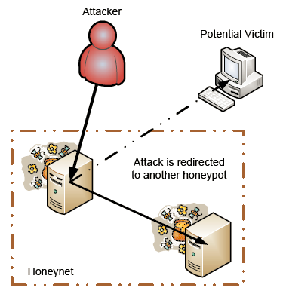
Honeypots
This is a computer that is used as “bait” for intruders.
It is often placed on network in a way that makes it attractive, such as having it configured with software with known vulnerabilities and having its hard drive full of documents that appear to contain company secrets.
Effective
Intrusion detection
Evidence
Diversion

